Slide 1
Educare Future Scholars Program
CAAB DC Saves Forum
June 27, 2019
Alexa Verme
Assistant Director, EHS Partnershps
averme@educaredc.org

Slide 2
Educare DC: Overview
Opened in 2012 in Parkside-Kenilworth neighborhood in Ward 7
Serves 160 children ages 6 weeks – 5 years with a full-day, full-year Early Head Start/Head Start program
Part of a 23-school national network
that started in 2000 in Chicago
Educare’s evidence-based program proven to narrow achievement gap for young children living in poverty
Program, policy and research

Slide 3
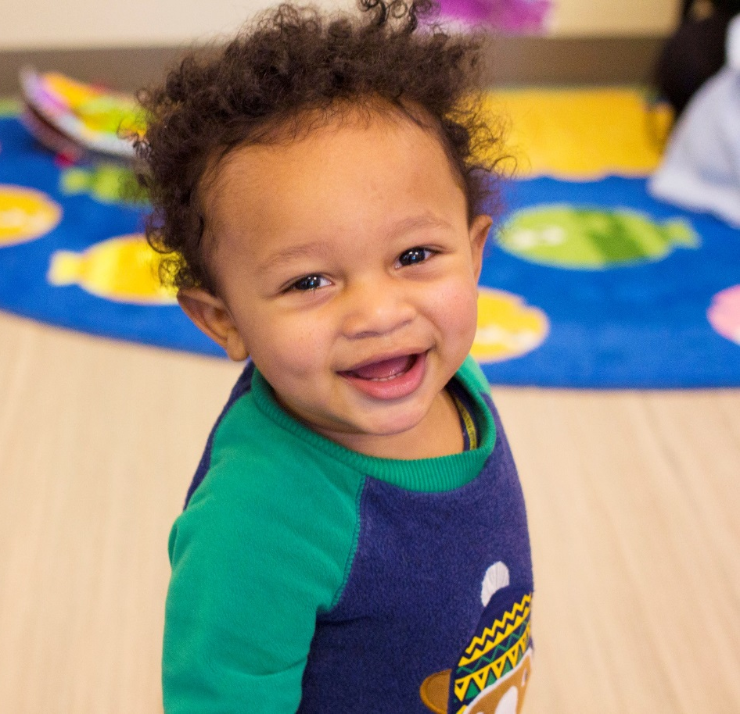
Features of the Educare Model
High-quality teachers
Research-based practices
Instructional coaches
Intensive family engagement
Comprehensive services
Strong local partnerships
Local evaluation partner (UMD)

Slide 4
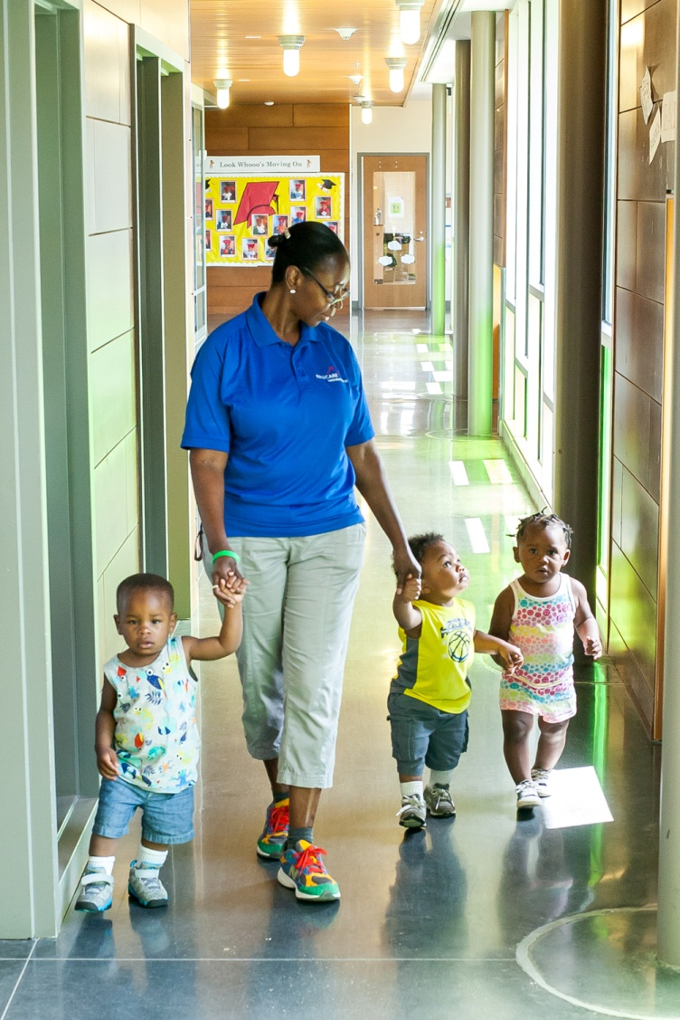
Educare Future Scholars
Began in August 2016
Universal: all enrolled children receive a 529 “Scholarship” fund
Program Goals:
Build good habits for school (Attendance, literacy, and family engagement)
Encourage families to open 529 Family Savings Accounts and save
Support financial literacy through community partnerships and workshops

Slide 5
Questions?

