Slide 1
The Racial Wealth Divide
Dedrick Asante-Muhammad
Chief of Equity and Inclusion
National Community Reinvestment Coalition

Slide 2
The Foundation of Racial Inequality
“The foundation of racial inequality is racialized economic inequality and the foundation of economic inequality is wealth inequality.”
Race and Economics in the US:
Racial Inequality has always had economic inequality at its foundation.

Slide 3
Narratives Shape Our Reality
The MYTH:
There is a system that works, and communities of color are doing something wrong
In their finances
On the job
Personal decisions
The TRUTH:
Our economy is designed to reward the wealthy and leave others behind
An upside down tax system
Residential economic segregation
Lack of investment in disenfranchised communities

Slide 4
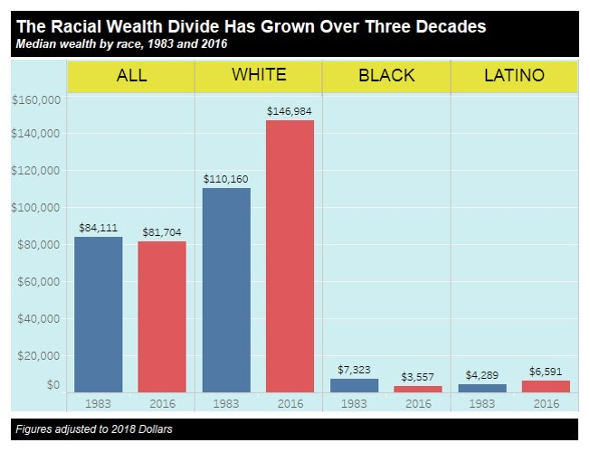
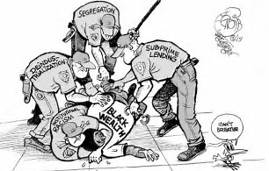
Racial Wealth Divide 1983 - 2016
Notes:
“The majority of white Americans consider themselves
sincerely committed to justice for the Negro. They believe
that American Society is essentially hospitable to fair play and
to steady growth toward a middle-class utopia, embodying
racial harmony. But unfortunately this is a fantasy of self-deception and comfortable vanity.” – Dr. Martin Luther King Jr.

Slide 5
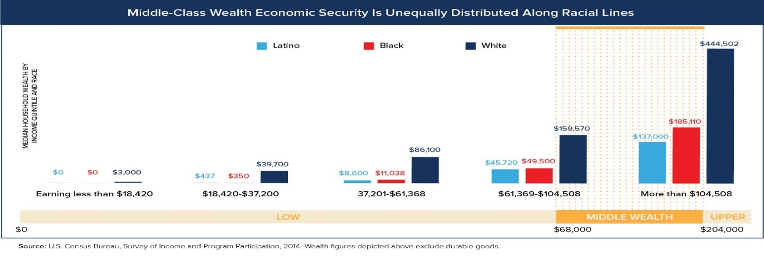
The Disconnect Between Income and Wealth
Notes:
Income vs Wealth

Slide 6
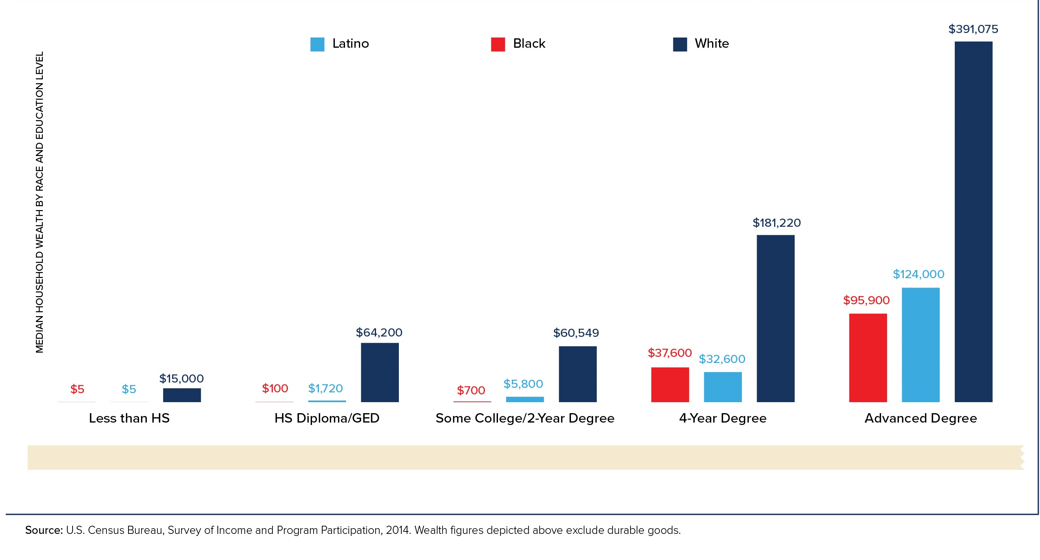
The Disconnect Between Education & Wealth
Notes:
“Depressed living standards for Negroes are not simply the
consequences of neglect. Nor can they be explained by the
myth of the Negro’s innate incapacities, or by the more
sophisticated rationalization of his acquired infirmities (family
disorganization, poor education, etc.). They are a structural
part of the economic system in the United States.” – Dr. Martin Luther king Jr.

Slide 7
The Negative Feedback Loop of Black Asset Poverty
LACK OF HOUSEHOLD ASSETS
57% of Blacks are in liquid asset poverty. (Do not have enough liquid savings to replace income at the poverty level for 3 months)
Median household income is $36,651.
INFERIOR PUBLIC ASSETS
Black communities most often live in areas with inferior public assets: public schools, public safety, public health, public transportation
INFERIOR SERVICE FROM THE MARKET:
Products sold in communities of asset poverty are inferior and often times more expensive than similar products available to high income communities.
SEGREGATED FROM SOCIO-ECONOMIC OPPORTUNITY:
Living wage jobs and social networks are located outside of the communities asset-poor Blacks live in.
GREATER FINANCIAL RESPONSIBILITIES
Debts, pent-up demand & need for financial support from family & community means increased income go toward consumption then
asset development

Slide 8
Black & White Profiles
Median Black Household:
Income: 36,651*
Wealth: 3,400
Average Credit Score (of homebuyer): 677**
Renter
Median White Household:
Income: 61,018*
Wealth: 140,500
Average Credit Score (of homebuyer): 734**
Homeowner
Median credit score by income:
Low income (<50% of MFI***): 664
Moderate (50-79):716
Middle: (80-119): 753
Upper: (120): 775
Notes:
* https://www.census.gov/content/dam/Census/library/publications/2017/demo/P60-259.pdf
** Source: https://www.valuepenguin.com/average-credit-score#nogo. Note: This is the median credit score for homebuyers.
*** Median Family Income

Slide 9
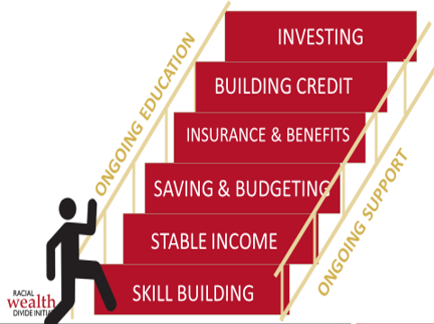
Investing: Building assets with a return through achieving individual and/or family Return On Investment (ROI) through knowledge and access to: building asset; access to “Safe” investment vehicles; and public incentives.
Building Credit: Achieving a knowledge base of credit prospects, the utilization of credit as a vehicle to support individual and/or family living and how to protect against the loss of credit through inappropriate credit decisions.
Insurance and Benefits: Achieving individual and/or family financial sufficiency to serve as a guard against unforeseen financial emergencies and protection of assets.
Savings and Budgeting: Achieving income levels, through employment, that is sufficient enough to support individual and/or family living and future saving potential, which meet daily living and/or emergencies. Savings is an essential element.
Stable Income: Achieving stability in achieving and maintaining financial resources with specific attention to knowledge and access to: reliable basic goods and services; quality jobs and opportunities; getting assets; and skills related to work, taxes and benefits.
Education and Skill-building: Represents an enhancement of educational competency at a variety of intersecting points, including, but not limited to: K-12 education; financial education and counseling; and wealth building education.
3 levels of financial security
Can pay expected incoming bills and cost
Increasing financial savings and assets while paying incoming bills and expenses
Attained enough wealth and assets where they become an additional income stream beyond the income from work.

Slide 10
Categories of Assets
Housing: Housing is an asset that helps one secure, capitalize and save. Housing should provide a safe and supportive place for a household to reside. Housing is most often at the center of all other forms of assets .
Employment Income Food Security
Childcare Education Health Care Transportation
Family/Social Relation Community Resources Community Involvement
Legal Finance and Financial Resources Safety

Slide 11
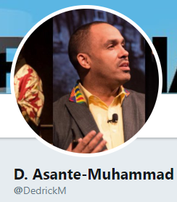
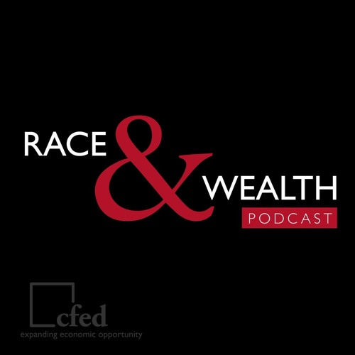
Stay Connected
Bridging the Racial Wealth Divide
facebook.com/racialwealthdivide
soundcloud.com/rwdpodcast
twitter.com/DedrickM
inequality.org/topics/racial-wealth-divide
ncrc.org

